Slide 1
Progress report 26/09
Anh Tuan Cao

Slide 2
Overview
Bearing ring Dataset (continue)
Open relay Dataset
Continual learning in predictive maintenance
Water surface detection
Question and Answer from last meeting
Dynamic output expansion

Slide 3
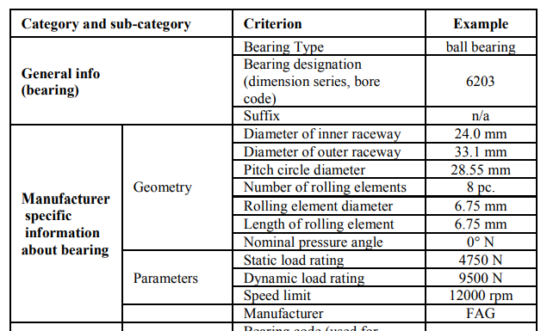
1. Bearing ring dataset (Continue)
Bearing Dataset – Uni Paderborn
One bearing ring model is used in this experiment

Slide 4
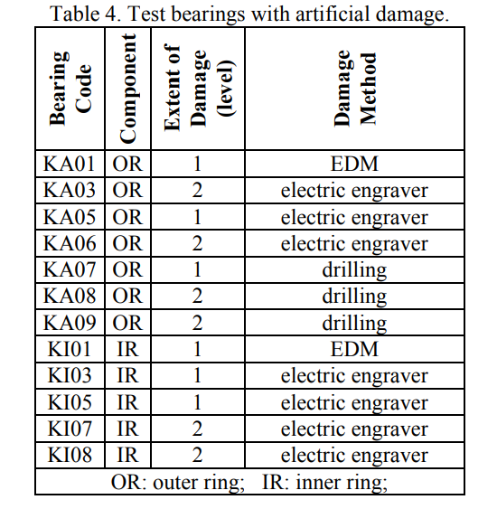
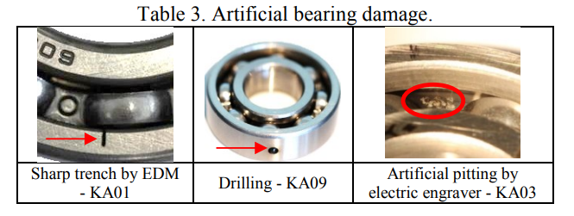
1. Bearing ring dataset (Continue)
Bearing Damage
Bearing Damage is generated either by artificial or real damages
Artificial damage:
electric discharge machining (trench of 0.25 mm length in rolling direction and depth of 1-2 mm),
drilling (diameter: 0.9 mm, 2 mm, 3 mm)
manual electric engraving (damage length from 1-4 mm).

Slide 5
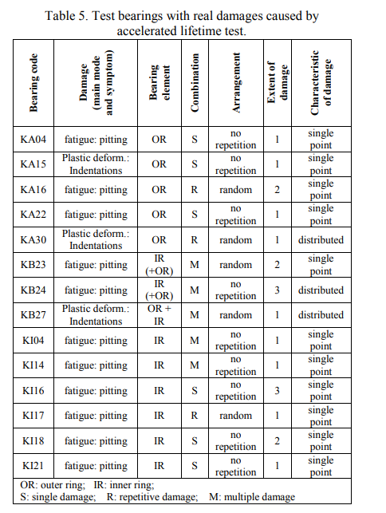
1. Bearing ring dataset (Continue)
Bearing Damage
Bearing Damage is generated either by artificial or real damages
Real damage is generated by accelerated lifetime test.
Estimate the long-term performance, reliability, and lifespan of a product or component within a shorter time frame than would be possible under normal usage conditions.
This is achieved by subjecting the product to intensified stress factors, such as increased load, temperature, pressure, humidity, vibration, or electrical stress,

Slide 6
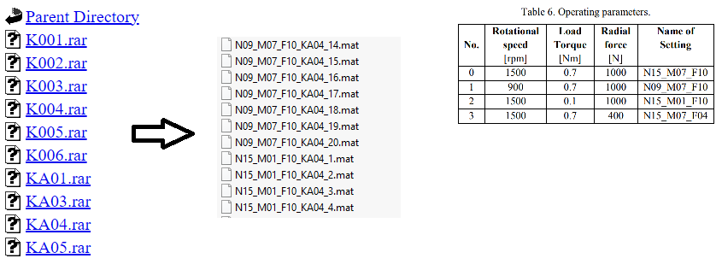
1. Bearing ring dataset (Continue)
Bearing data
The dataset is divided into multiple files with experiment on a bearing ring with bearing damage code.
Each scenario is run with different settings (operating parameter) and each setting is recorded 20 times.
Each measurement is recorded into a mat file

Slide 7
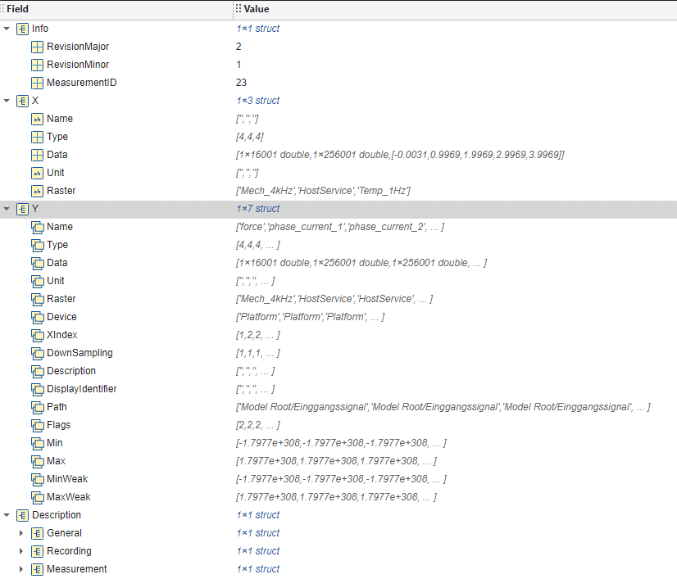
1. Bearing ring dataset (Continue)
Bearing data
Each mat file contain information of a measurement.
For example: IDs, timestamp, duration, personal, etc..

Slide 8
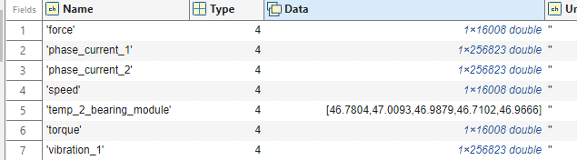
1. Bearing ring dataset (Continue)
Bearing data
We are only interested in Y field
Measuring time is 4s
It contain:
Operating parameter with sampling rate of 4 KHz.
Two motor current signal with sampling rate of 64 KHz.
Vibration Signals with sampling rate of 64 KHz.

Slide 9
1. Bearing ring dataset (Continue)
Motor Current Signal and Vibration Signal
Motor Current Signal: Motor current signals refer to the electrical signals derived from the current flowing through the motor. These signals contain valuable information about the operating conditions of the motor and bearings.
Advantages:
Non-invasive and can be monitored remotely without requiring direct access to the bearing or motor.
Cost-effective compared to vibration sensors as it uses existing electrical signals.
Limitations:
Less sensitive than vibration analysis for early-stage fault detection.
Requires advanced signal processing techniques to accurately extract fault features due to noise and other electrical disturbances.
Vibration Signal: Vibration signals are physical signals captured using accelerometers or other vibration sensors placed directly on the bearing housing or nearby structures. These signals measure the mechanical vibrations caused by the bearings.
Advantages:
High sensitivity to bearing defects, especially in the early stages of damage.
Provides detailed information about the nature and severity of the fault.
Can detect a wide range of faults, including misalignment, imbalance, and looseness, in addition to bearing issues.
Limitations:
Requires direct sensor placement, which may not always be feasible.
Sensors can be costly, and installation requires careful positioning for accurate measurements.
Vibration data can be complex to interpret, requiring specialized knowledge and signal processing.

Slide 10
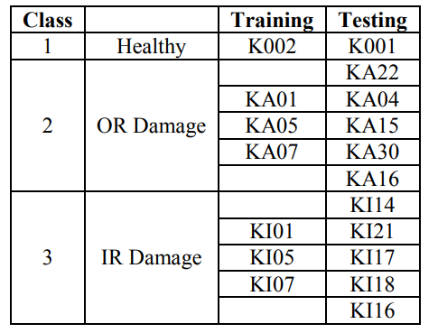
1. Bearing ring dataset (Continue)
Damage classification
Data preprocessing: extract frequency feature with (FFT and PSD) -> Feature extraction: 23 distinct Feature
Feature: 9 out of 23 features are selected from each of the two MCS per sample and 15 features from the vibration signals.
Then separate data into test and training data

Slide 11
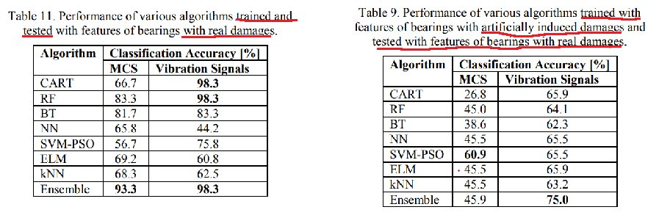
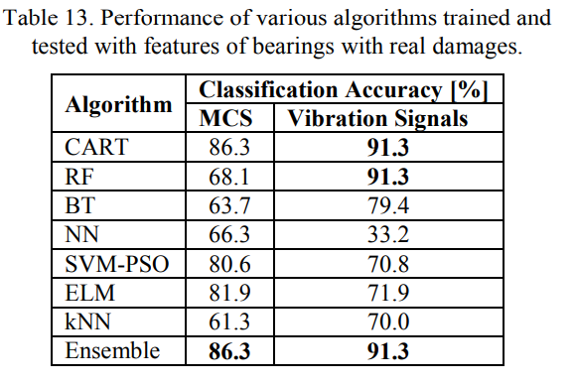
1. Bearing ring dataset (Continue)
Damage classification
Different machine learning methods are used on different scenario (single damage only vs with multiple damage)

Slide 12
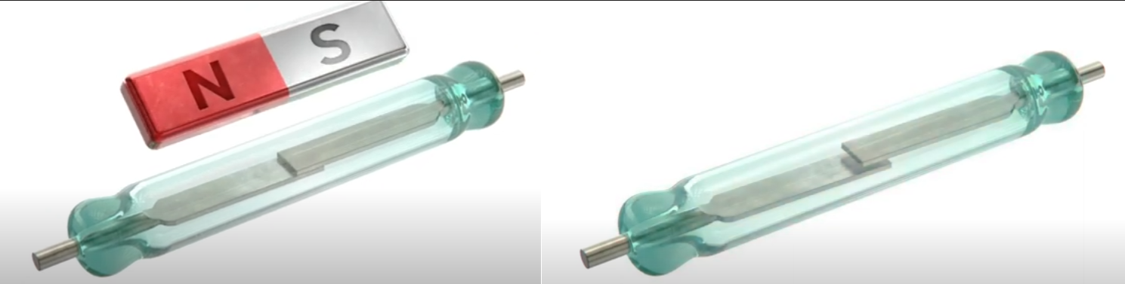
2. Open relay dataset
Relay basic operation:
Relays use an electromagnetic coil to control the movement of internal contacts. When a control signal is applied to the coil, it generates a magnetic field that either closes or opens the relay’s contacts, depending on the relay type.
This mechanism allows a low-power control signal to operate a high-power circuit, providing electrical isolation between the control and the load.
A (Normally) Open relay is a type of relay in which the default state of the relay contacts is open, meaning that no current flows through the circuit when the relay is not energized.

Slide 13
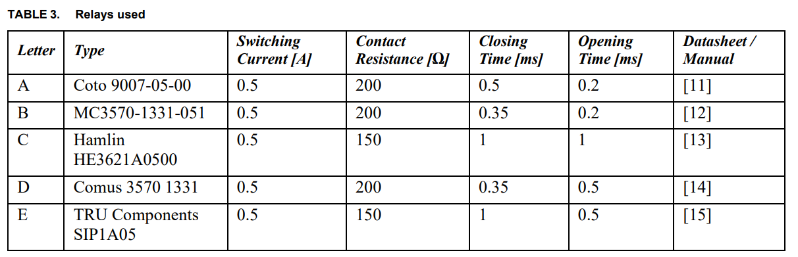
2. Open relay dataset
Relays used in dataset:
All of the relays used in this dataset are normally open reed relay with different characteristics

Slide 14
2. Open relay dataset
Relay characteristics
Switching Current: Switching current is the maximum current that a relay can handle through its contacts during the switching operation without damaging or degrading the contact surfaces.
Contact Resistance: Contact resistance is the resistance across the closed contacts of the relay when it is in the ON state. This resistance consists of the inherent resistance of the contact material and any resistance introduced by contact wear or contamination. High contact resistance can lead to voltage drops, signal distortion, or heat generation.
Closing Time (Operate Time): Closing time, or operate time, is the time taken for the relay contacts to close after the coil is energized.
Opening Time (Release Time): Opening time, or release time, is the time taken for the relay contacts to open after the coil is de-energized.

Slide 15
2. Open relay dataset
Relay Degradation
Switching Operation and Arc Formation:
During the switching process, there is a brief period when the contacts are close but not fully connected.
In this state, the air gap between the contact tongues becomes very small, allowing a voltage flashover to occur. This flashover creates a small electrical arc.
Effects of Arcing on Contacts:
The arc that forms during switching is a high-energy event that causes localized heating and physical erosion of the contact surfaces.
Over time, the repeated formation of arcs degrades the contact surfaces, altering their condition and increasing the contact resistance. This degradation is progressive and can lead to significant wear.

Slide 16
2. Open relay dataset
Relay Degradation impact
Switching Current: As relays degrade, the switching current capability can be reduced due to the wear and erosion of the contact surfaces.
Contact Resistance: Contact resistance increases as the relay ages due to surface wear, oxidation, and the buildup of contaminants.
Closing Time (Operate Time): The closing time of a relay can become longer as the relay's components wear out.
Opening Time (Release Time): Similar to closing time, the opening time may also become extended.

Slide 17
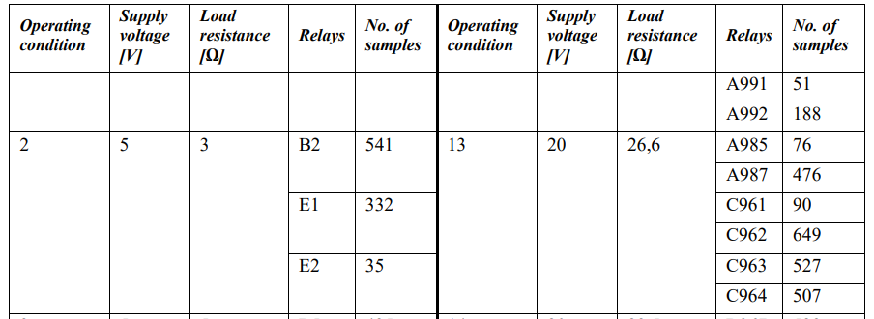
2. Open relay dataset
Relay Degradation data collection
Using the test bench, 100 relays were opened and closed alternately under 22 different operating conditions defined via the supply voltage and the load resistance.
2 different operating conditions defined via the supply voltage and the load resistance (see Table 4) until failure. For every 50th cycle, the voltage curve during opening and closing of the load circuit of the respective relay as well as the contact resistance were measured.
For each relay, the corresponding metadata, i.e. in particular the number of cycles until failure, the supply voltage and the load resistance, were also stored.

Slide 18
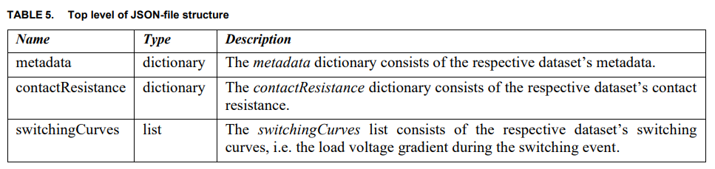
2. Open relay dataset
Relay Degradation data collection
Data is for each types of relay is stored in a Json file.
We are interested in contact resistance and switching curves.

Slide 19
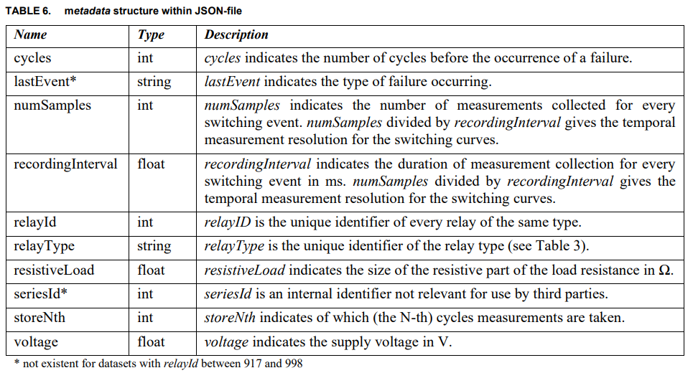
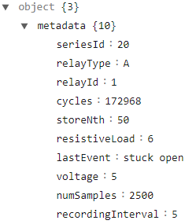
2. Open relay dataset
Metadata structure
Cycles: each cycles consist of 2 event: close and open.
Recording Interval is 5μs for the switching curves.

Slide 20
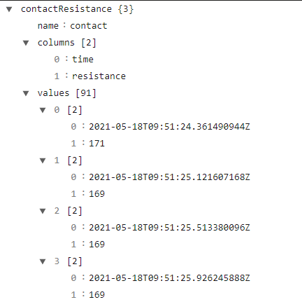
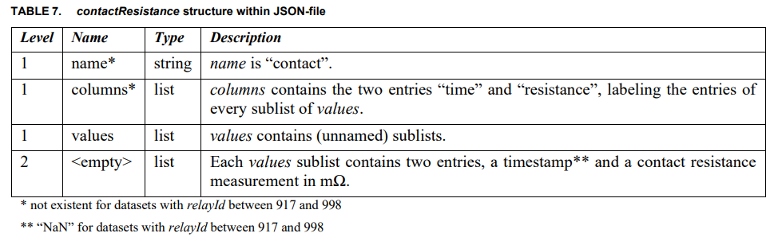
2. Open relay dataset
Contact resistance structure
The contact resistance measurements that are included correspond to the time period where switching curves were collected.
For example in A1 data is record starting in closing event at cycle 65051 timestamp 09:51:30.511507176Z and end at opening event at cycle 65101 timestamp 09:52:50.16548796Z.
Then contact resistance measuring should start and ends around that time (from 09:51:24.361490944Z to 09:53:00.723117056Z), measuring interval is unknown.

Slide 21
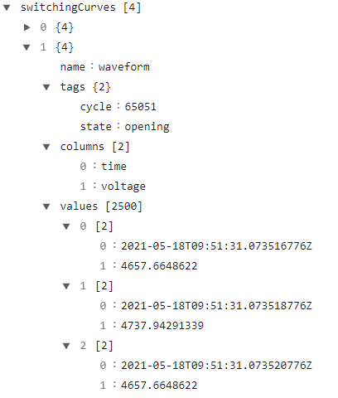
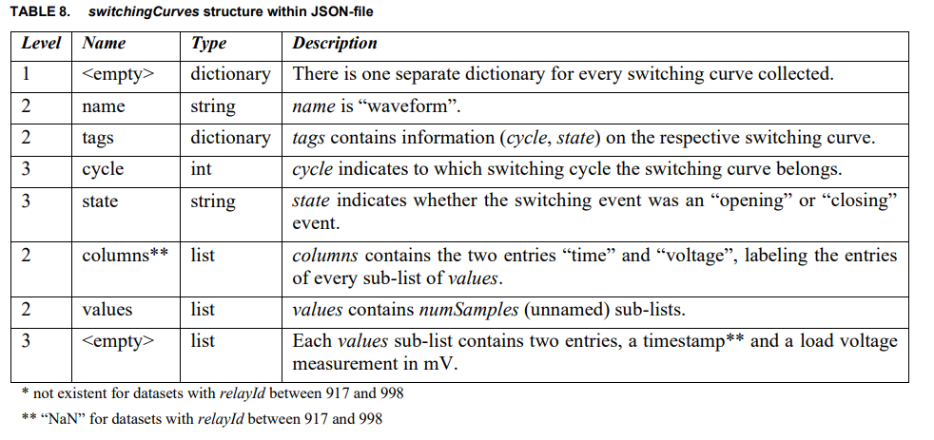
2. Open relay dataset
Switching curves structure

Slide 22
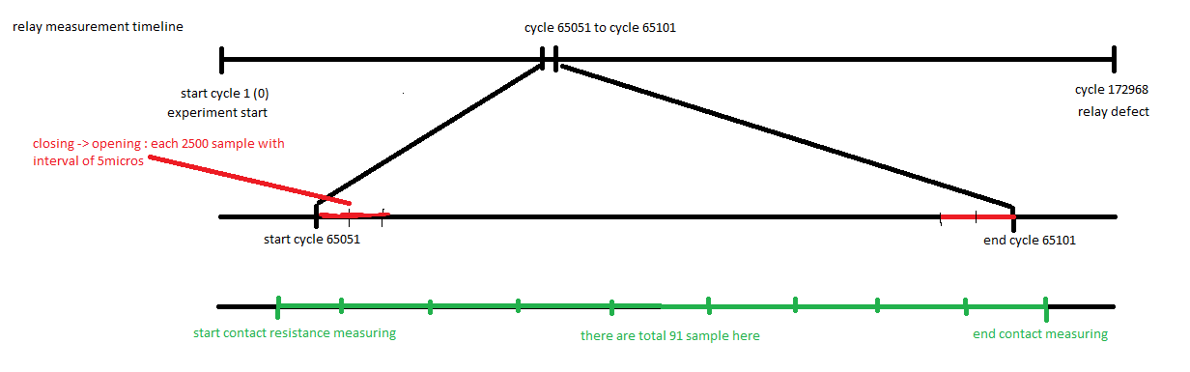
2. Open relay dataset
Measurement timeline overview
Not all of cycle are recorded, only random interval of time in the life cycle is recorded.
Contact resistance and switching curves data is not aligned in time.

Slide 23
3. Continual learning in predictive maintenance
Problem formulation
Continual learning scenario is task or domain incremental learning base on the parameters.
The problem is now regression (classification is also possible).
Each task consisted of data with known failure.

Slide 24
3. Continual learning in predictive maintenance
Example: HDD dataset: overview
One task now include one or more samples.
For each model we select the model that it's failure day is known.
In real life scenario, we keep collecting the data every day, until 1 drive is defect, then compose the data into 1 sample. Then feeds these samples into the models for continual learning.
With this model we can have an use case:
A program that detects HDD has 30 days till failure.
A program that detects sudden decrease of days till failure of a HDD

Slide 25
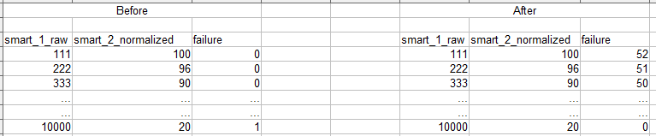
3. Continual learning in predictive maintenance
Example: HDD dataset: data transformation
Supposed that we only interested in smart_1_raw and smart_2_normalized
Chose data of a HDD, which is defected, an gather its data from a specifics N days
We can also transform HDD models name or HDD specific stats into number as input to change problem into tasks incremental learning.
For labeling: example if we limit N = 40 we can label every failure > 40 to 40.

Slide 26
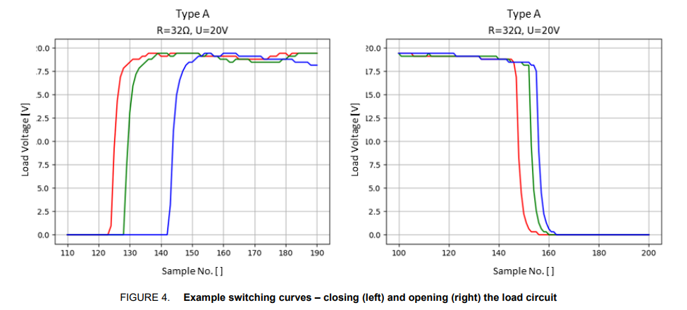
3. Continual learning in predictive maintenance
Example: Open relay dataset
Same logic can be applied to open relay dataset.
Each sample can be each relay (we can also remove relay types to make problem become domain incremental learning)
For each data row in one sample we can label by cycles remaining: last cycle – current cycle
For input parameter: open_timestamp_(1), close_timestamp_(1), contact_resistance (corresponding)

Slide 27
4. Wafer surface defect detection
Semiconductor production process
Early Detection: Identifying defects early in the manufacturing process helps prevent defective products from moving further down the production line, saving costs associated with further processing, assembly, and packaging.
Feedback for Process Improvement: Classification data provides valuable feedback to the manufacturing process, helping engineers identify and correct process issues that cause defects.
Maximizing Usable Products: Classifying defects helps in segregating wafers that are still usable for specific applications, thereby improving the overall yield.
Targeted Repairs: For certain defect types, corrective measures can be taken to repair the wafer, salvaging what would otherwise be a complete loss.

Slide 28
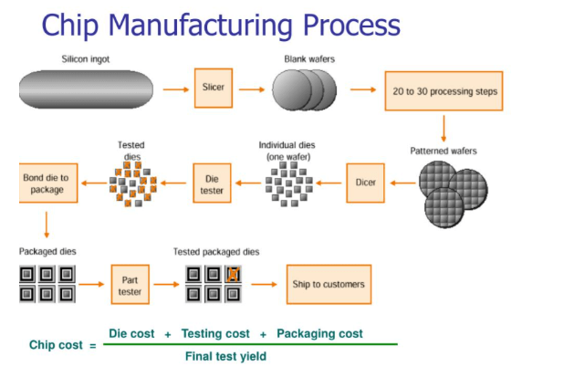
4. Wafer surface defect detection
Why wafer failure detection is needed:
Silicon Wafer Production: Production of the Wafer disk.
Wafer Fabrication: building the microscopic structures of transistors, capacitors, and other components on the wafer surface.
Wafer Testing and Dicing: Electrical tests are performed on each chip (die) on the wafer to check functionality before packaging. Then the wafer is cut into individual dies using precision saws or lasers.
Packaging, Assembly and shipping : component attachment and further testing.

Slide 29
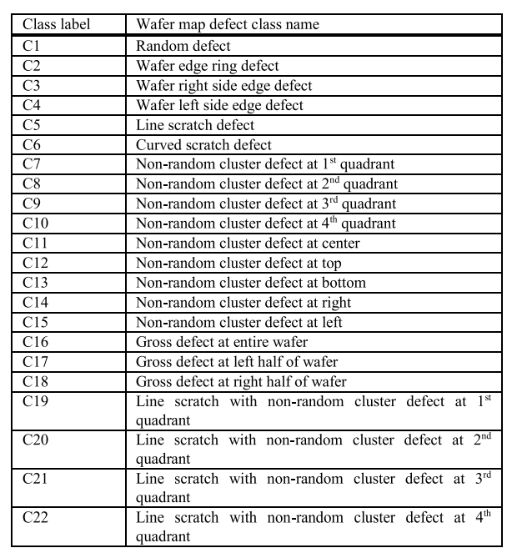
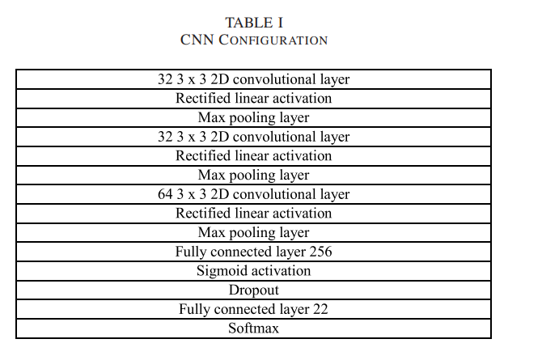
4. Wafer surface defect detection
Related paper
Wafer Map Defect Pattern Classification and Image Retrieval Using Convolutional Neural Network.
Dataset: generation using either pure random defect pattern, or random and non-random mixed pattern. Then label:
The input wafer map image size is 286 x 400.
Model is CNN

Slide 30
4. Wafer surface defect detection
Continual learning scenario
Class incremental learning can be applied in here.
For each task we can include more defect patterns.
But it does not make much sense in practice. Because most of defect pattern is already discovered and total number of pattern is also limited.

Slide 31
5. Question and Answer from last meeting
HDD life span calculation for each vendor:
What is maximum deformation
Histogram and correlation of SMART attribute example

Slide 32
5. Question and Answer from last meeting
HDD life span calculation for each vendor:
What is maximum deformation
Histogram and correlation of SMART attribute example

Slide 33
5. Question and Answer from last meeting
HDD life span calculation for each vendor:
What is maximum deformation
Histogram and correlation of SMART attribute example

Slide 34
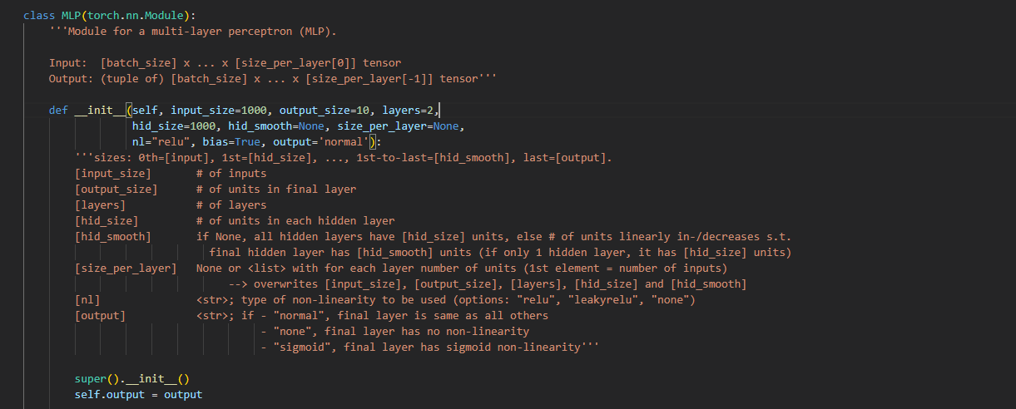
6. Dynamic output expansion
Example code
It is not mention in 'Three types of incremental learning' codes

Slide 35
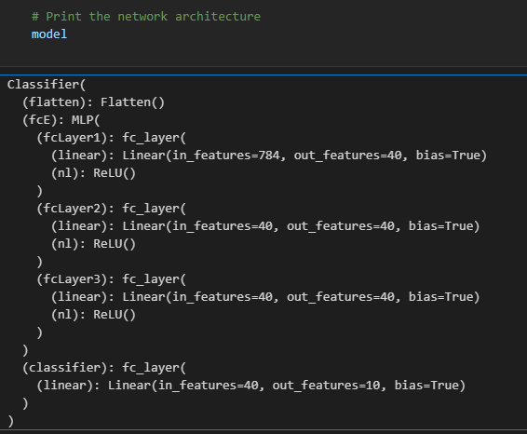
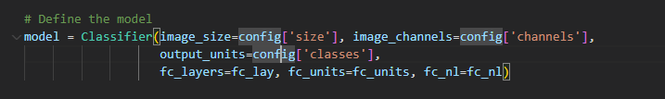
6. Dynamic output expansion
Example code
It is not mention in 'Three types of incremental learning' codes

Slide 36
6. Dynamic output expansion
Keyword for theme search
Keyword:
Dynamic Output Expansion
Class-Incremental Learning with Expanding Class Space
Open-ended deep learning model
No results matches the problem
Class incremental learning survey: https://arxiv.org/pdf/2302.03648
Incremental learning survey: https://arxiv.org/pdf/2302.00487
Both did not mention this problem.

Slide 37
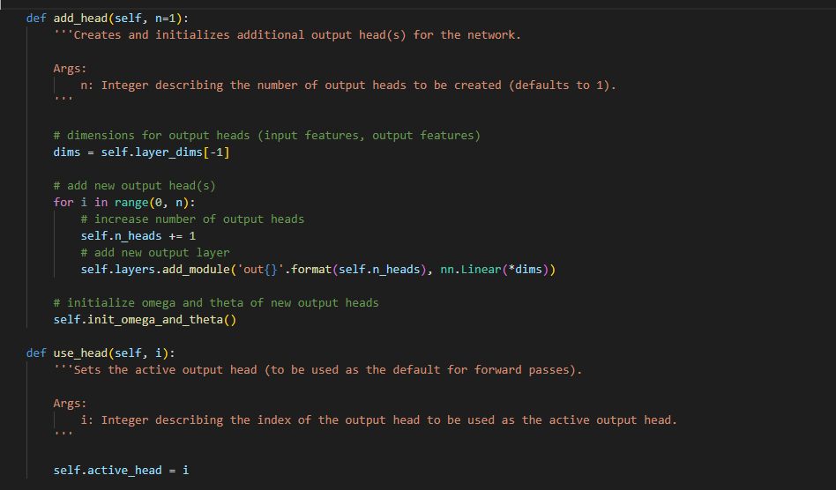
6. Dynamic output expansion
More example code
Code is taken from paper

